Slide 1

Continuous Architecture Initiative
Overview

Slide 2
Outline
Approach
Modeling techniques
Appendix

Slide 3
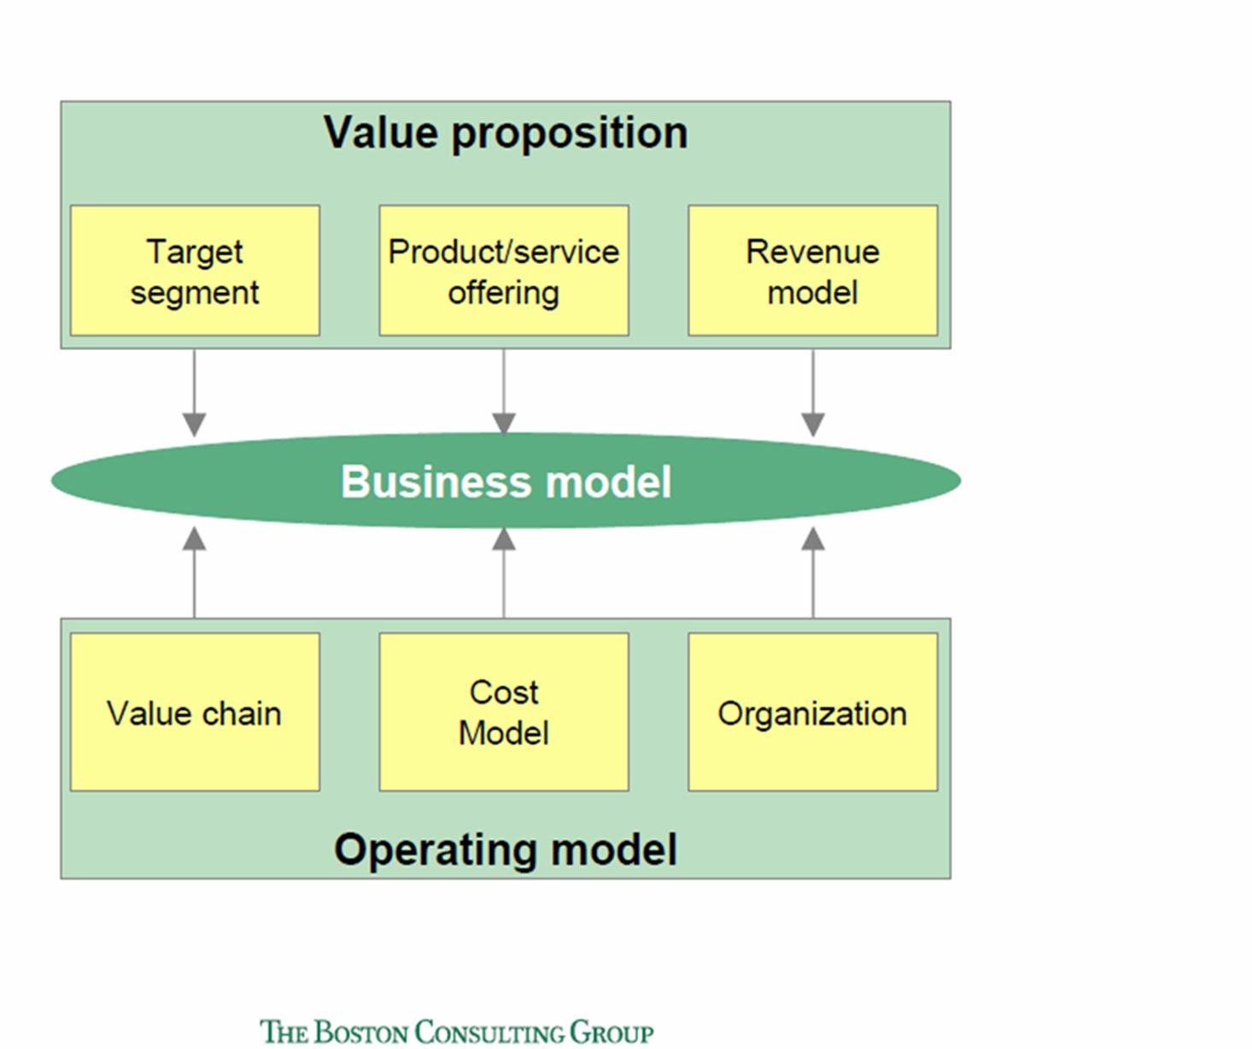
Building Blocks to shape your Business Model
Agile Strategy
BUSINESS MODEL
Experience
Product
Revenue Model
Software
Value
Platform
Operations
Organization
Cost, investment & risk Model

Slide 4
Waterfall is not fit for purpose in a digital world
Paraphrasing Field Marshal Helmuth von Moltke : “No plan survives contact with the enemy”… No Business Model survives contact with customers and competitors…
Estimated operating costs may invalidate strategy
Target operating model may require higher than anticipated IT costs
IT investments may not deliver expected benefits
Projected cash flows from Business Model may be over-estimated
…
Strategy & Business Model
cascading
iteration
Target Operating Model
IT Architecture

Slide 5
Waterfall and siloed approach
Strategy & Business Model
Target Operating Model
BU Strategy
Value proposition
Target segments
Brand
IT Architecture
Organization design
Process
Target setting
Value Chains
Core business
Revenue Model
Governance
Cost Model
Performance management
Road map
IT infrastructure
Digital capabilities
Roles & Responsibilities
Share services
Risk management
Sourcing
IT Software
DATA
Change management
Portfolio management
Location

Slide 6
Generic approach to be customized at 3 levels
Agile Strategy
Business Unit
Feedback
Inverse Conway Maneuver
Value Area
Concurrent Engineering
Product Family
Product
Agile
Organization
Experience
Operations
Platform
Roadmap
Optional Pilot*
Software
Deployment Waves
* E.g., MVP, Beta Site, etc.
Learning cycle

Slide 7
Systemic & iterative approach
Enterprise
Architecture
Agile Strategy
Roadmap
Value Area
Architecture
Experience
Product
Product Family
Architecture
Organization
Operations
Platform
Software

Slide 8
Business Unit Level
Agile Strategy
Experience
Product
Operations
Software
Platform
Organization
Roadmap
Top-Level OKRs
Customer Experience Vision
Product/Market Segmentation
Required Capabilities
Candidate IT Platforms
Platform Strategy
Organization Design*
Major
Milestones
Value Streams***
Platform Standards
Leadership model**
Experience Segmentation
Product Families Identification
Smart Offering enablement
Candidate
Operations Platforms
Revenue Model
Intelligent Automation Enablement
Platform Governance
Governance
Model
Value Areas Definition
Candidate
Product Platforms
Sourcing
Analytics
Enablement
Location
Includes
* Organization charts
** Culture model
*** Macro-Processes
Cost, Investment, Risk Model
Data Architecture Blueprint
Security Requirements

Slide 9
What makes a good platform?
Compelling to use
It cannot stand on a mandate alone
Clear accountability
Establish clarity of ownership while ensuring alignment through “city planning”
Managed as a product
Product thinking helps ensure that every platform feature adds value instead of creating constraints and coupling…
Leverage standardization
Facilitates composition and integration
Minimizes coupling with platform consumers
Preserve platform consumers’ autonomy
Allows for self-service
Provisioning, configuration, management & operation of platform capabilities and assets

Slide 10
Value Area Level
Agile Strategy
Experience
Product
Operations
Software
Platform*
Organization
Roadmap
Value Area Vision
Jobs To Be Done (level 3)
Product Families Definition
Journey Maps
Sample
Non-Functional Requirements
Required IT Platforms
Agile Teams Topology
Integration Events Identification
Jobs Maps
(level 3)
Differentiating
Features
Value Streams Definition
Trade-Offs Analysis
IT Platforms Run Cost
Management Practices
Economic Model Adjustment
Integration Events
Experience Maps
Sample
Guardrails and Fitness Functions
Job Story Clusters
Digitization Strategy
Product & Operations Platforms Feasibility**
Change Management Strategy***
Roadmap Adjustments
Objectives and Key Results (OKR)
User Stories
Sample
Commonality
Analysis
Sourcing Strategy
Patterns and Standards
Big Picture Event Storming and Strategic DDD
Data Architecture Patterns and Data Product Feasibility
Architecture Decision Records (ADR)
* Platforms are managed as products
** Required and supplied
*** Include social partners consultation
Security Architecture

Slide 11
Product Family Level
Agile Strategy
Experience
Product*
Operations
Software
Platform*
Organization
Roadmap
Jobs To Be Done
Product
Scoping 360°
Journey Mapping
Architecture
Runway
IT Platforms Consumption Model
Deployed OKRs
Prioritized
Jobs To Be Done
Backlog
Product Family Vision
R
Value Stream Mapping
Jobs Maps
Architecture
Kata
Team Autonomy Readiness
Product
Features
R
Product Portfolio Definition
Product & Operations Platforms Integration
R
Prioritized
Feature backlog
Value Stream improvement / (Re)Design
R
Experience Maps
Peer Review
R
Product User Stories
New Ways of Working
R
Dependency Management
Operability Review
User Stories
Product Business Case
Smart Process Automation
R
Security Review
Individual Change Management
Prioritized
User Stories backlog
Event Storming and Tactical DDD
Security Implementation
* Feasible Platforms and Data Products are created by Lean Product & Process Development
Architecture Decision Records (ADR)
Data Architecture
R
Rituals or family of rituals

Slide 12
Modeling Techniques Overview
“Hierarchy, I shall argue, is one of the central structural schemes that the architect of complexity uses”
The architecture of complexity, Simon 1962
Experience Requirements
Product Scenarios
Strategic DDD Scenarios
Jobs Hierarchy
Jobs To Be Done Analysis
Jobs Maps
Journey Mapping
Value Stream Mapping
Event Storming
Jobs Stories
Journey Steps
VS Steps
Domain Events
Entity Objects & Life Cycles
* Non-Abstract Large System Design
User Stories
Product Design
Commonality Analysis
Bounded Context Canvasing
Jobs Stories Clustering
Candidate Product
Components
** System-Theoretic Process Analysis
Features
Candidate Shared Capability
Boundaries & Dependencies
Evolution & Emergence
Jobs Clusters Hierarchy
Operations Hierarchy
Software & Hardware Hierarchy
System Thinking
Design Structure Matrix (DSM) Analysis
Collaboration and Responsibility Analysis
NALSD*
STAMP**
Etc.

Slide 13
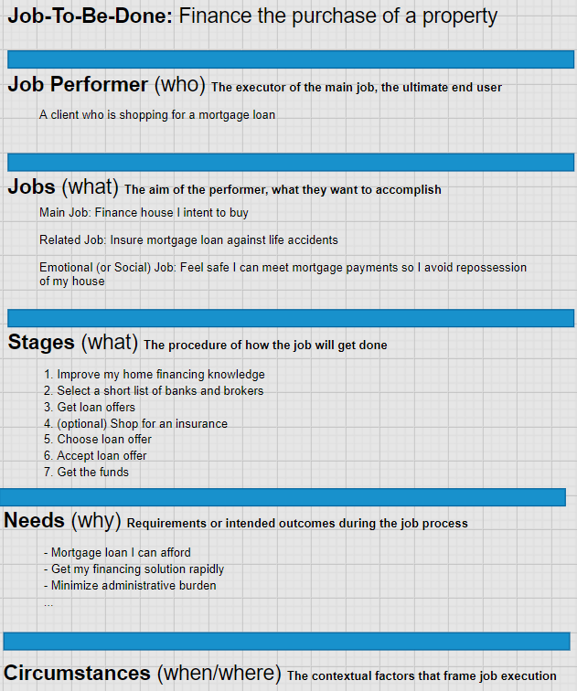
Jobs To Be Done
A job is a goal or an objective independent of your solution
A job statement is Verb + Object + Clarifier
It shouldn’t include adjectives like quick, easy, or inexpensive which are needs
The aim of the job performer is not to interact with your company, but to get something done
Your service is a means to an end, and you must first understand that end
Strive to frame jobs in a way that makes them stable, even as technology changes
Source: Jim Kalbach, The Jobs To Be Done Playbook

Slide 14
Branch visit example
"Our customers come into our branch not to get a product; they come in because they want to buy a car or they want to buy their first home, or they want to repair their credit and they need some help doing it."
Mary Mack, Head of Community Banking, Wells Fargo
Banks need to design their branches around what jobs their customers need help with. Look at why customers visit bank branches. What jobs are they doing there?
For simple transactions like to deposit money or cash checks, banks should take a cue from Southwest Airlines
For several years, the airline has offered multiple kiosks for customer self-service check in with one or two lobby agents available to help with technical challenges or complex transactions. This is a benefit for both the bank and the customer. Higher volumes of transactions can be managed, and with fewer resources.
Infrequent branch visitors usually visit to talk to a banker about a loan, mortgage, credit card, or some problem with their account. The jobs that these visitors are trying to solve require more care are typically resolved with longer-term, higher-dollar products (e.g., mortgages and auto loans rather than checking accounts)
These customers need more guidance, regulators require more disclosure, and expect more service while completing jobs like buying a new home—and both customer and bank can benefit by offering more human interaction and personal value. Offering more value for these types of jobs can result in higher value customer purchases and longer, more loyal relationships.
Can bankers be mobile and visit these infrequent customers in their homes? Why not do it via Skype?
It’s worth the investment to help these customers complete their jobs as efficiently as possible—they are usually the most profitable

Slide 15
Choose the right level to cluster jobs
“So not only do you have to move up and down in granularity, you also need to move from side to side and recognize adjacent goals. Related jobs can help you break up a big job into more meaningful sections.”
Jim Kalbach, The Jobs To Be Done Playbook
Level | Examples
Aspiration | Enjoy a home that meets the needs of a family that is teleworking
Big Job (L0) | Provide a physical workspace to each family member
Smaller Job (L1) | Get Internet access to all my devices
Smaller Job (L2) | …
…
Micro Job | Drink coffee at my desk
Higher Level Job
How?
Lower-Level Jobs
Why?

Slide 16
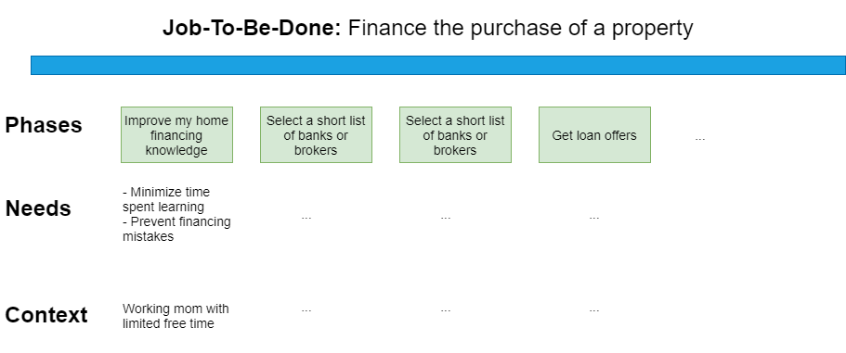
Job Map
““A Jobs Map is a view into the behaviors and needs of individuals in the context of their daily lives. That may or may not include your solution.”
Jim Kalbach, The Jobs To Be Done Playbook
A Job Map is not a Journey map
It is not about how people come to your solution, decide to purchase or stay loyal
Help discover specific innovative ideas to fulfill a job
Install Draw-io :
https://draw-io.en.softonic.com/
Double click on the icon below:

Slide 17
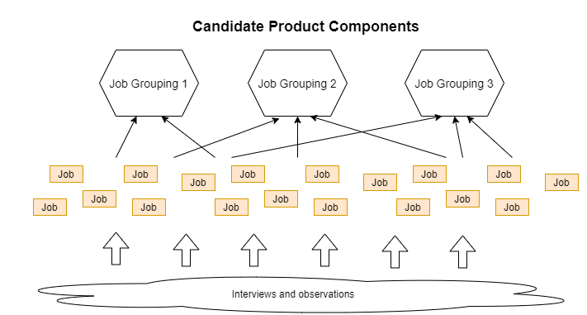
Input to product architecture
Good solutions mirror clients’ mental model of their Job-To-Be-Done
Look for affinities among jobs
Unlike a job map, which is chronological, a model of the solution will typically have no temporal component
By matching the structure people naturally use in practice, you can set up a lasting foundation for iterating your product
Young, Indi. Mental Models . Rosenfeld Media

Slide 18
Architecting operations Identify candidate shared capabilities
Standardization and reuse can only arise when
(1) a capability implements commonly useful activities; and
(2) Its interface and SLA satisfy the needs of more than one Value Stream
Identify commonly useful functions
Identify common activities/steps across Value Streams
Simulate credit, price, collect and verify documents, contract, disburse, compute commission, Etc.
Points of attention
Beware of activities that look similar but are not
Pay attention to
Negative impact on customer/user experience
Coupling that could slow down other agile teams

Slide 19
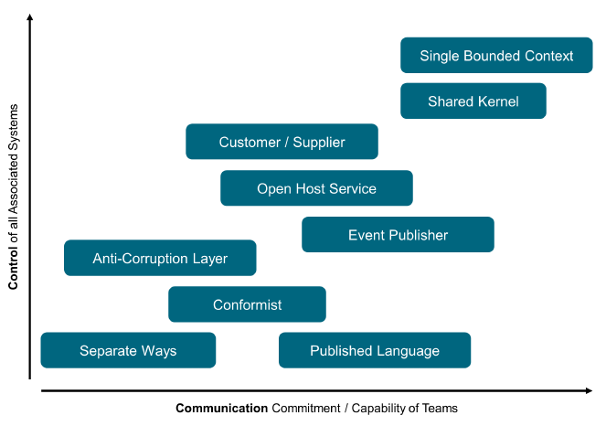
Architecting software systems
DDD Strategic Patterns
Sub- System C
Sub-System B
Sub- System D
Module
(e.g., GDPR)
Sub- System A
Sub- System …
Modularity: sub-systems and services can be developed and deployed independently
Change the implementation of one module without knowledge of the implementation of other modules and without affecting the behavior of other modules
Make most changes without changing any module interfaces
Make major software change as a set of independent changes to individual modules
Design Structure Matrix (DSM)
to measure modularity
CRC Cards (Class Responsibility Collaboration)
Low Coupling: minimize connection between sub-systems & modules
High Cohesion: high density of dependencies within a module

Slide 20
Appendices
Platform taxonomy
DDD example
Architecture Decision Record Example
Example of transformation setup

Slide 21
Platform taxonomy
Internal (Product) Platform | External Platform
 | Innovation Platform | Transaction Platform
Set of assets organized in a common structure from which a company can efficiently develop and produce a stream of derivative products (1) | Similar to an internal platform but provide the foundation upon which outside firms can develop their own complementary products, technologies, or services which add functionality to the platform (2) | A platform is a business based on enabling value-creating interactions between external producers and consumers. The platform provides an open, participative infrastructure for these interactions and sets governance conditions for them (3)
E.g. Vehicle platforms such as Toyota’s New Global Architecture | E.g. Apps added to the Android Play Store | E.g. Amazon marketplace
(1) “Industry Platforms and Ecosystem Innovation” By Gawer, Annabelle, and Michael A. Cusumano. J Prod Innov Manag 31, no. 3 (September 4, 2013): 417–433.
(2) “The Future of Platforms” by Michael A. Cusumano, David B. Yoffie, And Annabelle Gawer, Mit Sloan Management Review Spring 2020
(3) “Platform Revolution: How Networked Markets Are Transforming the Economy and How to Make Them Work for You” by Parker, Geoffrey G.; Van Alstyne, Marshall W.; Choudary, Sangeet Paul. W. W. Norton & Company

Slide 22
Defining digital platform
A Digital Platform consists of three repositories built on a base of cloud technologies:
A repository of reusable API-enabled software components each of which has code that stores, manipulates, analyzes, or displays some element of that data;
A repository of infrastructure components that provides technical service components such as authentication and access control or connectivity for smart devices;
A repository of business components that provides functionality required by multiple digital offerings
Source: Ross, Jeanne W.; Beath, Cynthia M.; Mocker, Martin. Designed for Digital (Management on the Cutting Edge). The MIT Press
A platform is a foundation of self-service APIs, tools, services, knowledge and support which are arranged as a compelling internal product
Autonomous delivery teams can make use of the platform to deliver product features at a higher pace, with reduced co-ordination
Source: https://martinfowler.com/articles/talk-about-platforms.html?s=03
N.B. These definitions position digital platforms as internal platforms

Slide 23
Defining transaction platform
Start with the design of the core interaction
It involves three key components: the participants, the value unit, and the filter
It should be as easy, attractive, and valuable to users as possible
The participants
The producer who creates value, and the consumer who consumes value
Value units
For example, on Uber the value unit are available cars
Filter
Algorithmic, software-based tool used by the platform to enable the exchange of appropriate value units between users
A well-designed filter ensures that platform users receive only value units that are relevant and valuable to them
A poorly-designed filter (or no filter at all) means users may be flooded with units they find irrelevant and valueless, which may drive them to abandon the platform

Slide 24
Business Unit Transformation Change Skills & Organization
Strategic League
Experience League
Operating League
Agile Strategy
Experience
Operations
Roadmap
Change skills
for each building block
or sub block
=
cross league skills
Product
Platform
Organization
Software League
Software
Data League
Data Architecture Blueprint
Security League
Security Requirements
Cost & Revenue League
Revenue Model
Cost Model

Slide 25
Digital and Agile 3 Architecture levels
Enterprise
Architecture
iteration
Iterative
Value Area
Architecture
Product Family Architecture

Slide 26
Business Unit Transformation Staffing transformation teams
Staffing Model
Transformation teams
Enterprise
Architecture
Change Skills
Run
Skills
Value Area
Architecture
Change Skills
Run
Skills
Product Family Architecture
Change Skills
Run
Skills

Slide 27
Business Unit Transformation Governance
Steering committee
Synchronization
meetings
Objects managed
Enterprise
Architecture
Business Board
Every 4 months
Strategic Coordination
Every 4 months
OKR,
Culture
New business
….
iteration
Iterative
Examples
Examples
Value Area
Architecture
Value Area Board
Every 2 months
Business Synchronization
Release
Emblematic KPIs
Management practices
Investments,
….
Product Family Architecture
Product Board
Monthly
Product Alignement
Sprint
Teams Backlogs
Ways of working
Weak signals
…

